Slide 1
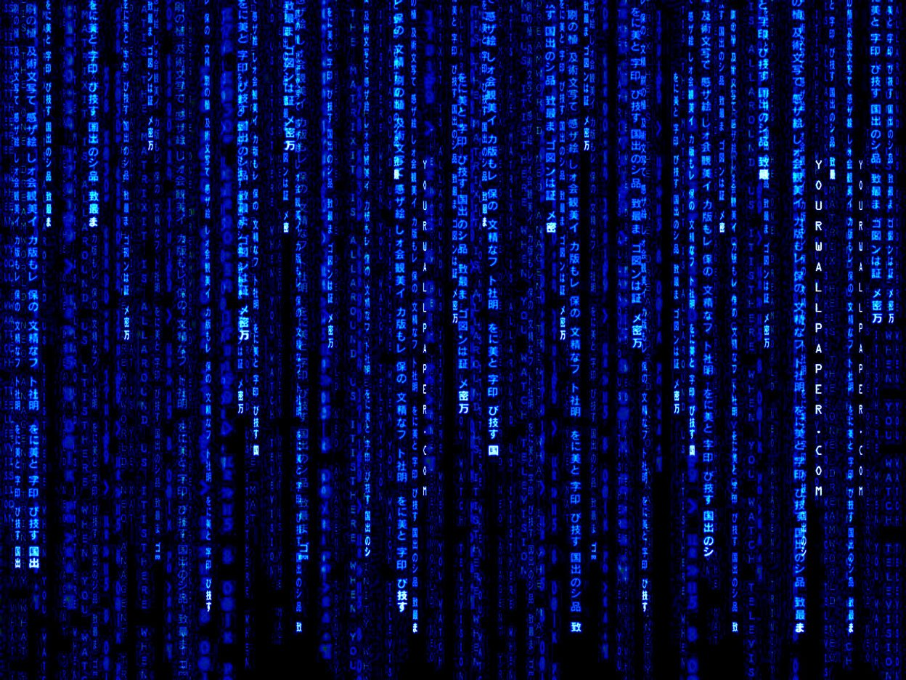



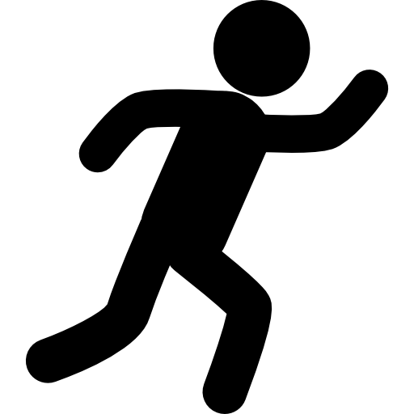


VIRTUAL
PAINTING
Vedant Rajpurohit (20SE02ML036)
Manan Patel (20SE02ML034)
Rinkesh Patel (20SE02ML035

Slide 2
I
N
T
R
O
D
U
C
T
I
O
N
This Project looks into Virtual reality (VR) offers a unique platform for visual representation. As means of communication, drawings frame the ways in which architects think about space.
Sketching On Air is possible through our trending technology namely open cv, python.
This Project (Virtual Painting) will be used to draw different shapes and free hand drawing
The interaction between people and the machines is mainly completed through the mouse, keyboard, remote control, touch screen, and other direct contact manner. While our project looks into the concepts of Virtual Reality (VR).

Slide 3
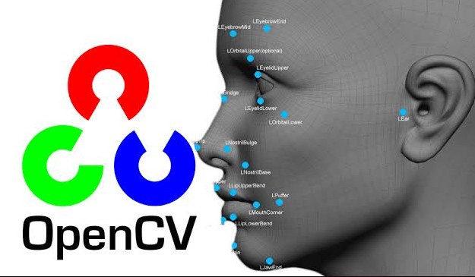
OPENCV
OpenCV (Open-Source Computer Vision Library) is a library which mainly focuses at real-time computer vision. It is free for both academic and commercial use. It has C++, C, Python and Java interfaces and supports Windows, Linux, Mac OS, iOS and Android. OpenCV was designed for computational efficiency and with a strong focus on real-time applications. The library has more than 2500 optimized algorithms, which includes a comprehensive set of both classic and state-of-the-art computer vision and machine learning algorithms. It provides basic data structures for image processing with efficient optimizations

Slide 4
O
B
J
E
C
T
I
V
E
To Create Virtual Canvas to Sketch.
To detect human fingers as colour Maker and draw things virtually on screen without even touching it. One can also draw Shapes accordingly.
To Add Morphological Operations (a broad set of image processing operations that process images based on shapes. In a morphological operation, each pixel in the image is adjusted based on the value of other pixels in its neighborhood.)
To create an interface between user and the System using different imported libraries and software.
It Can also be used as a learning platform for kids to comprehend different shapes and colors.

Slide 5
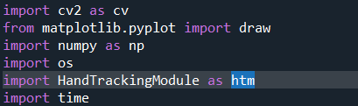
VIRTUAL PAINTING
OpenCV (cv2) : It is a library which mainly focuses at real-time computer vision
Matplotlib : It is library which is used to import graphs and charts (in this project used to import draw HandMarks and LandMarks)
Numpy : It is library used to create an flexible arrays
Os : It is operating system library used to import or remove images and files from the file explorer directories
HandTrackingModule : It is the module create by us to track hand landmarks.
Time :- It is library used to get time related values (in this project used to calculate FPS)
Libraries Used

Slide 6
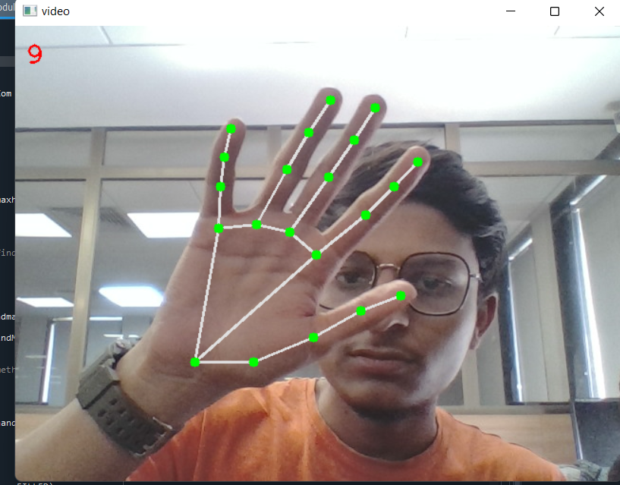
VIRTUAL PAINTING
HandTrackingModule
The Module create by us used to track all the HandLandMarks locations and assigning them with unique ID’s
The Number Showing at the Top left Corner shows the current Frame rate (FPS).
It can Track as many hands on the screen at time. If you increase the value of “maxhands” in the code.

Slide 7
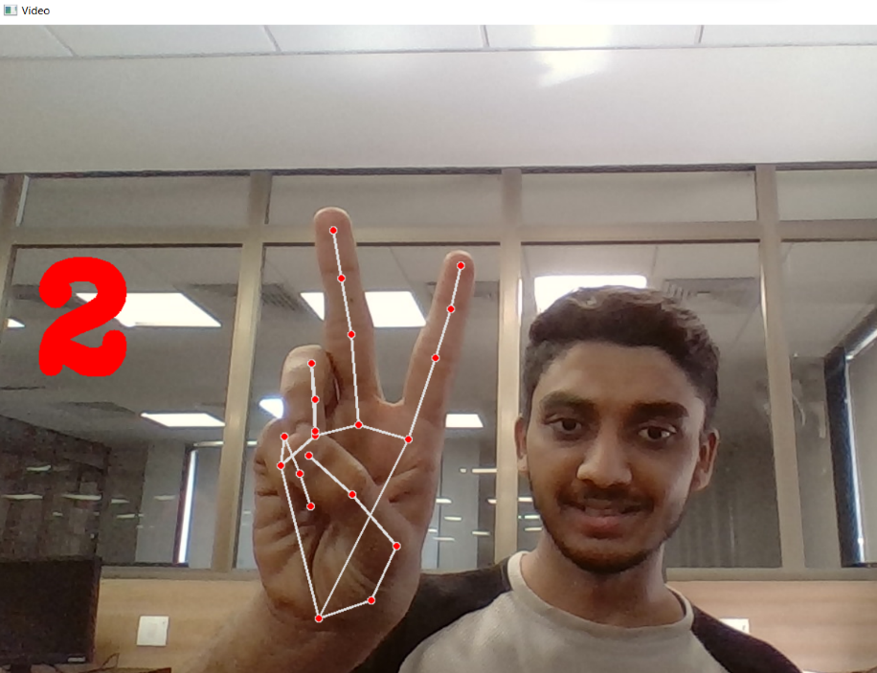
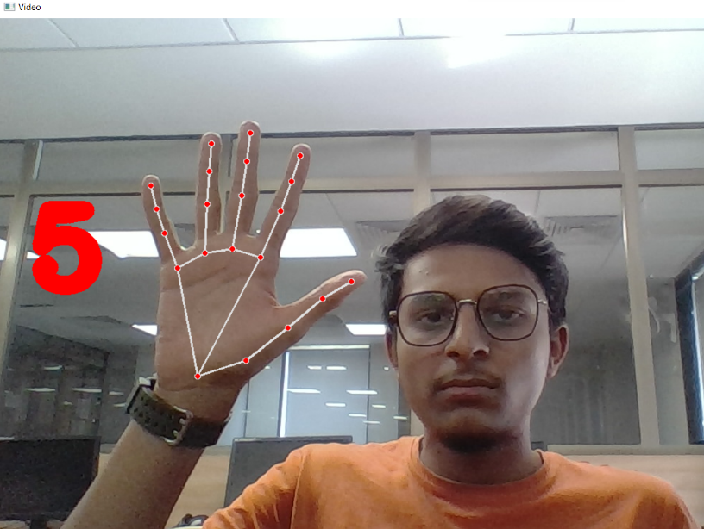
VIRTUAL PAINTING
Counting Fingers
The Module create by us used to track all the HandLandMarks locations and checking number of fingers open/Up and counting Them.
If no finger is up then it will show zero digit as no finger is open/Up

Slide 8
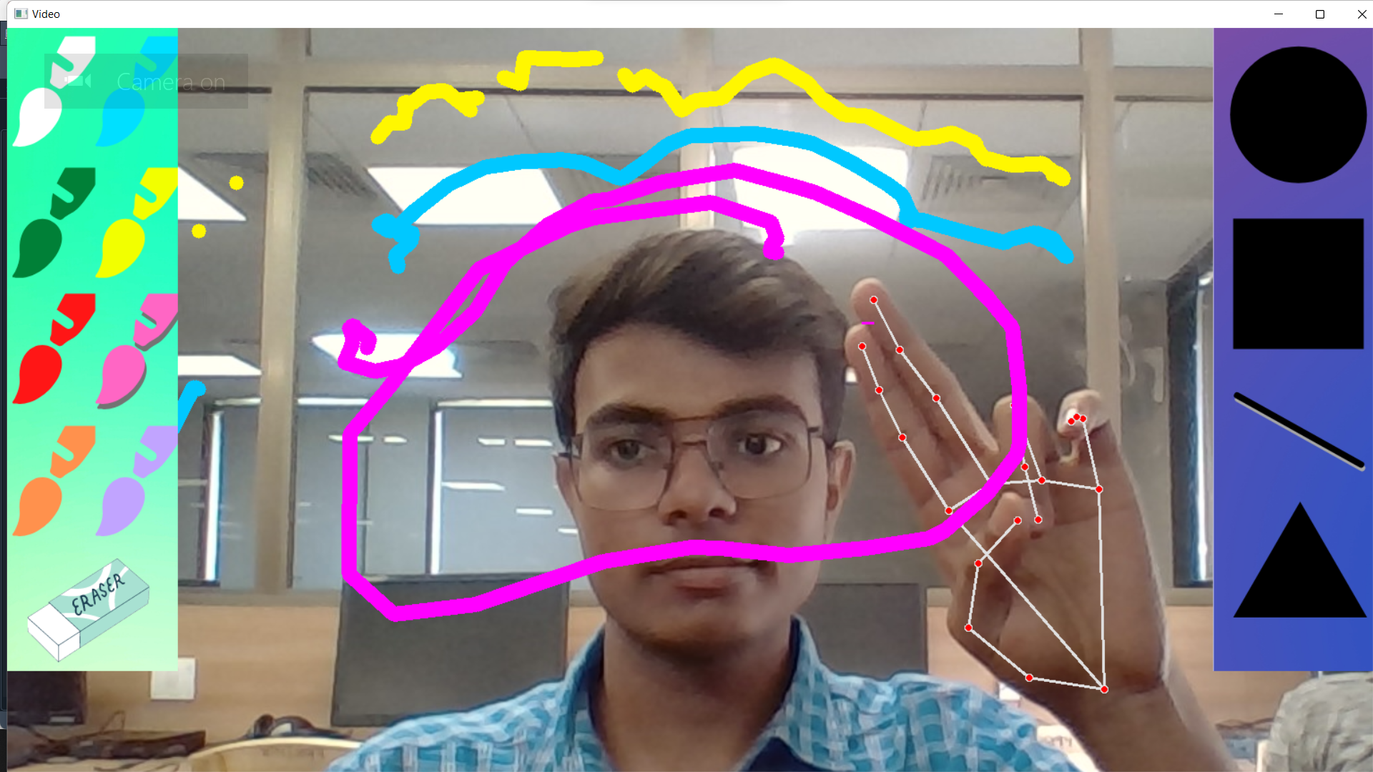
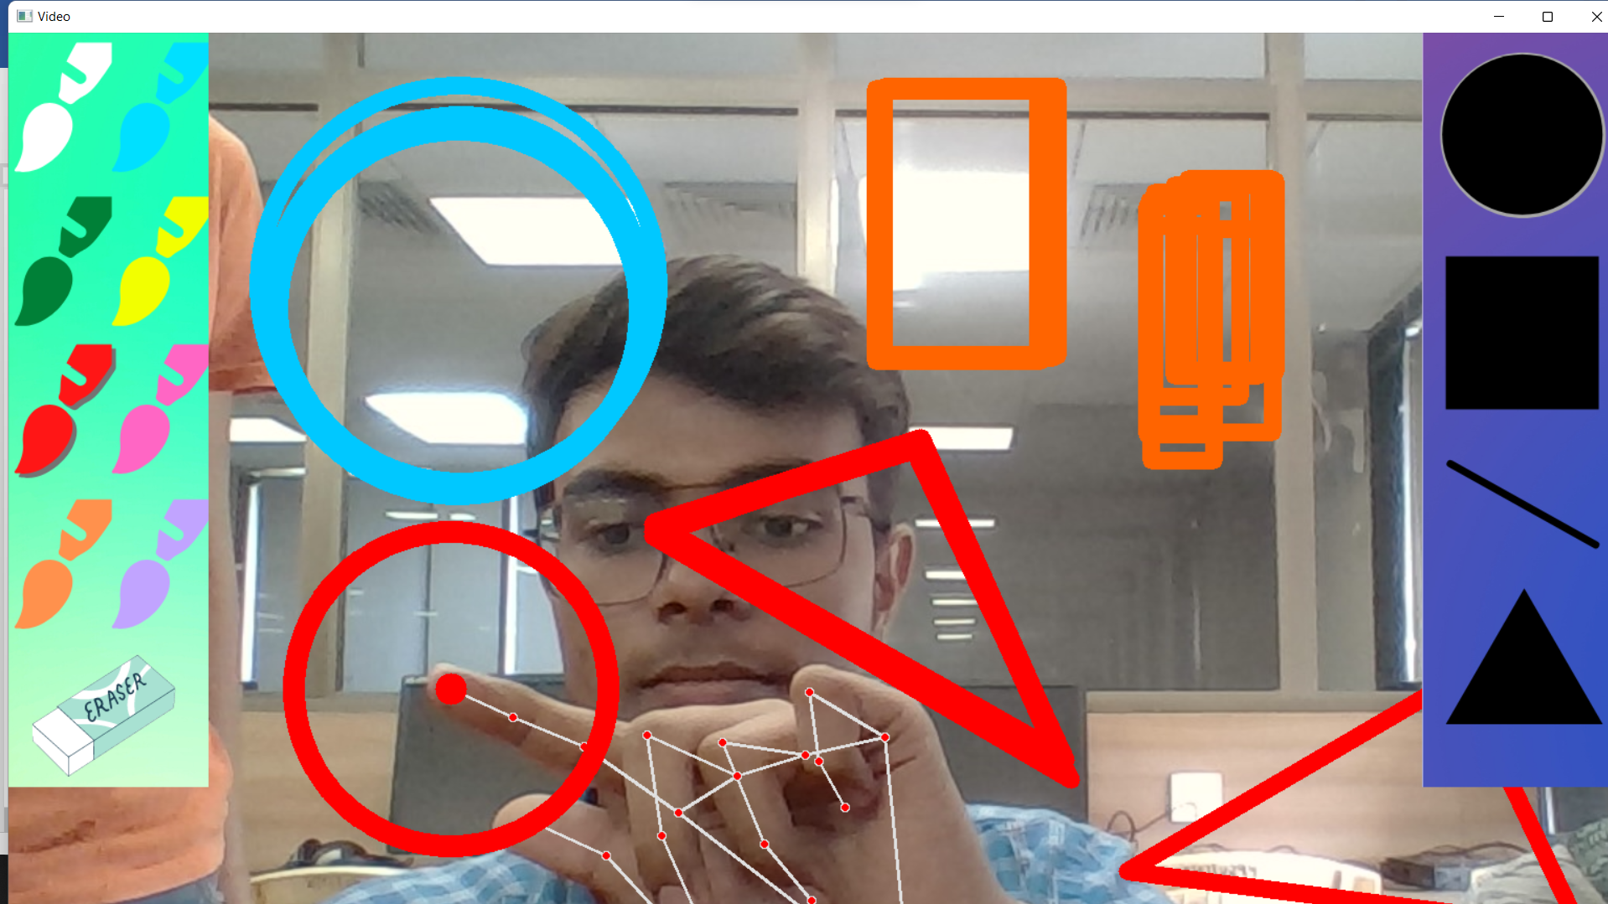
VIRTUAL PAINTING
Final Interface
The Final interface file created by importing all the other libraries and modules (HandTrackingModule and Counting Fingers).
This is the Final interface which user can use to create different drawings.

Slide 9
L
I
M
I
T
A
T
I
O
N
S
A person cannot identify a greater number of hands after a point.
You need a wide scale of screen to use it efficiently.
You cannot create 3-D structures
You need high brightness to detect hand and use if efficiently.
You need high system requirements and specific python libraries to use opencv hand and motion detection.

Slide 10
A
K
T
N
O
H
U
Y

